Slide 1
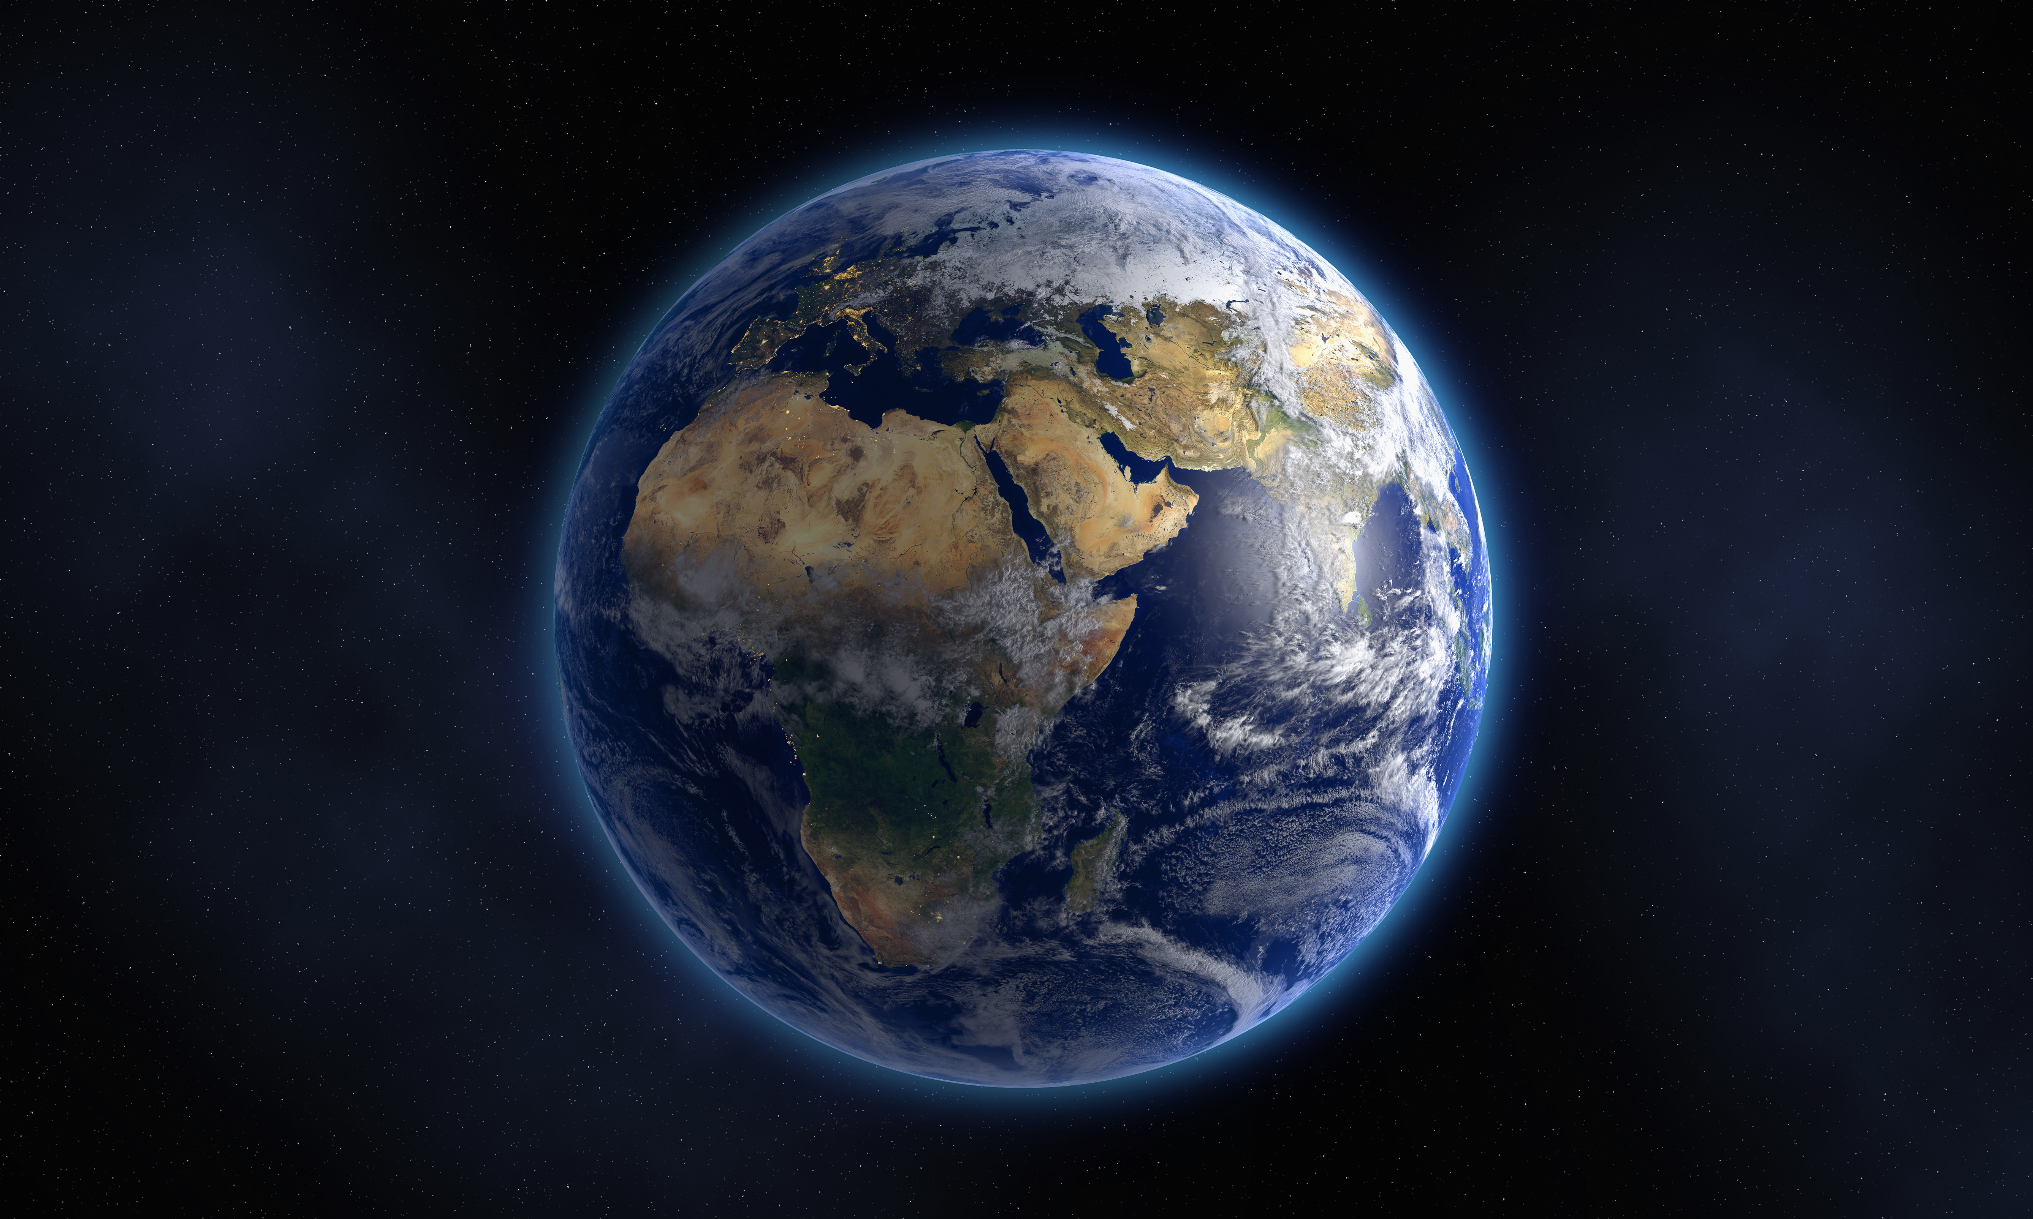
Astronomy Image Dataset - Capstone Project ST1
Advaith Ramakrishnan

Slide 2
Synopsis
Dataset Introduction
5 Questions
Libraries
EDA(Exploratory Data Analysis)
PDA(Predictive data analysis)
Implementation Plan

Slide 3
Dataset Introduction
Astronomy Image Dataset
Found on Kaggle, publicly available
Consists of 6 classes:
Constellations
Nebula
Cosmos Space
Planets
Galaxy
Stars

Slide 4
Questions
What is the accuracy of this model when tested?
What is the loss of this model when tested?
What is the distribution of light in these images?
How do I see the measurements of each image?
How can I change the colour of the image.

Slide 5
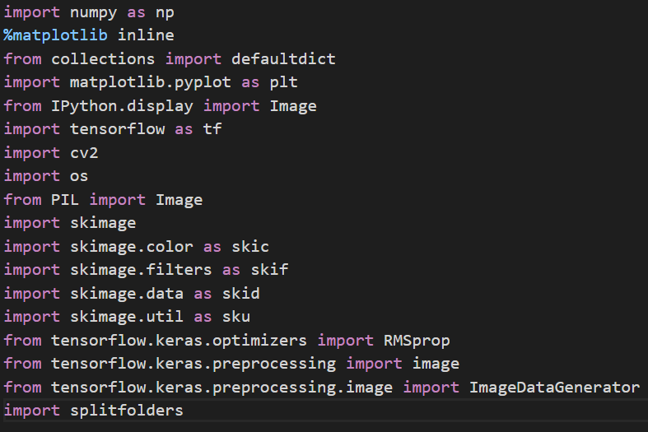
Libraries
All Libraries used in the notebook(EDA & PDA)

Slide 6
Exploratory Data Analysis
Split Folders

Slide 7
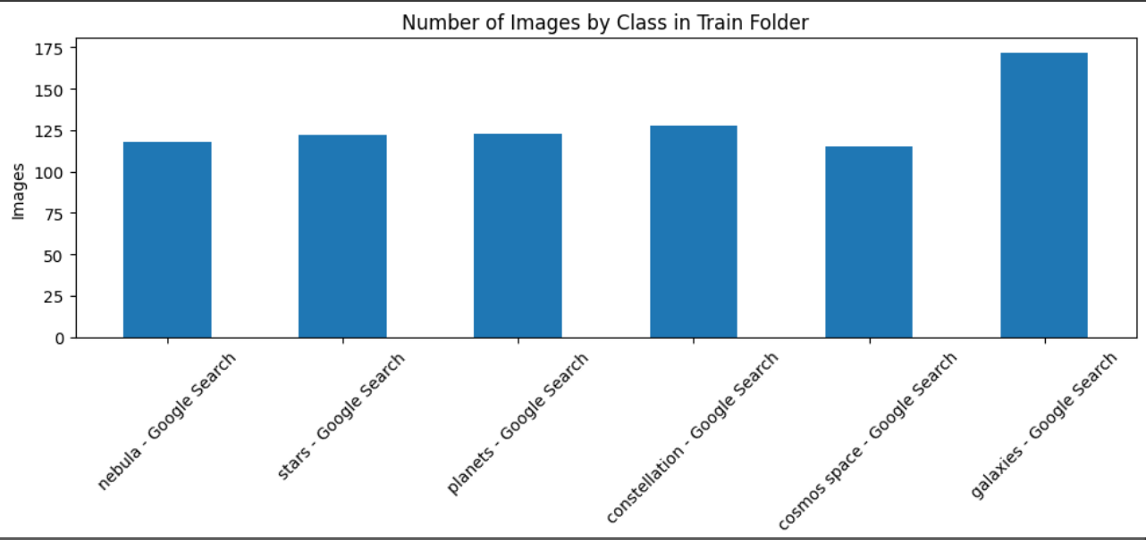
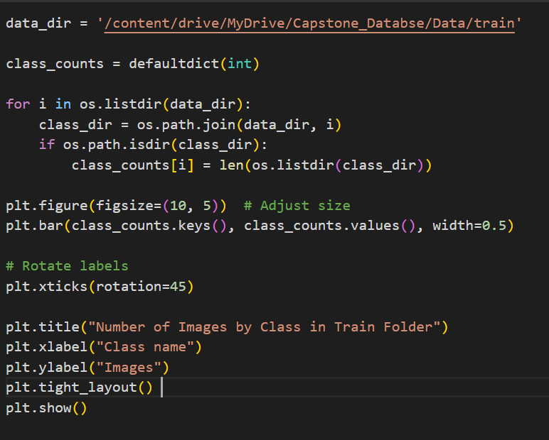
Exploratory Data Analysis
Number of Images Per Class in Train Folder
Change into Directory through os.listdir function
Through Matplotlib

Slide 8
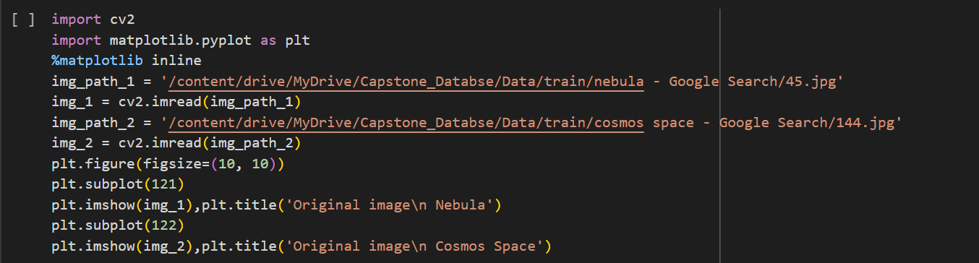
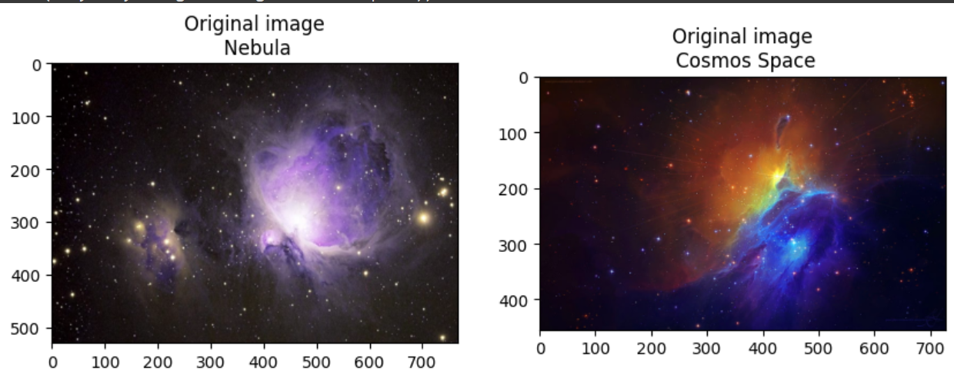
Exploratory Data Analysis
Displaying images from different classes
Using Matplotlib
To get basic understanding of how images will be displayed using plt functions.

Slide 9
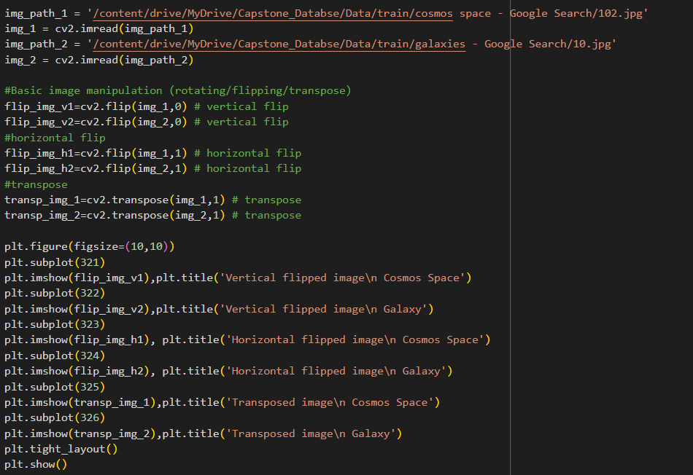
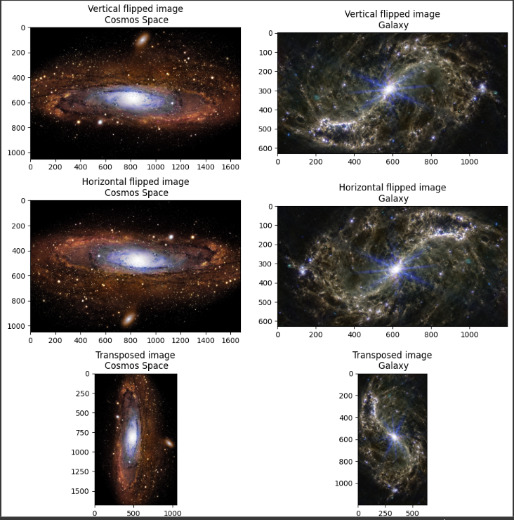
Exploratory Data Analysis
Geometric Transformation of Images
Flipping Images
Transposed Images
Images taken from galaxy and cosmos space classes.
Matplotlib
Cv2

Slide 10
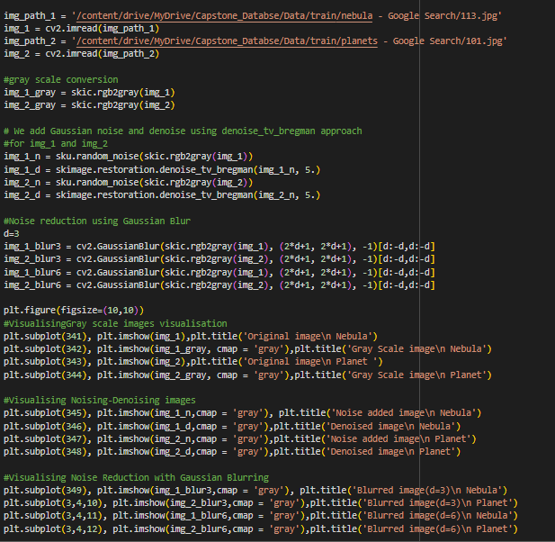
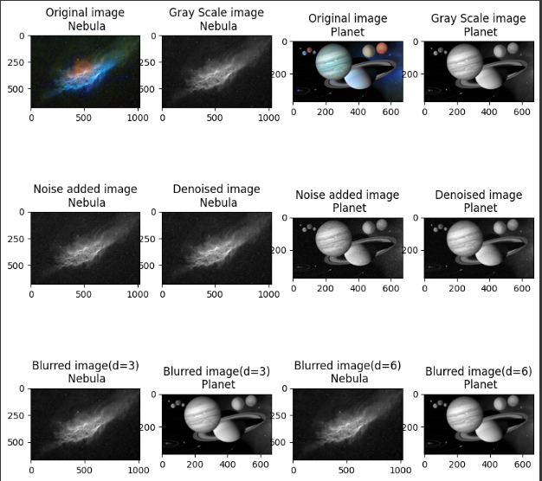
Exploratory Data Analysis
Color and Texture Feature Analysis
Matplotlib
Skimage to convert to gray scale image
Use of Skimage filter and skimage color functions
Gaussian Blue for Noise Reduction

Slide 11
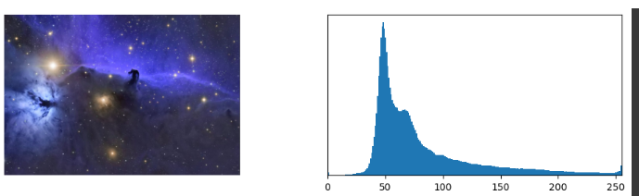
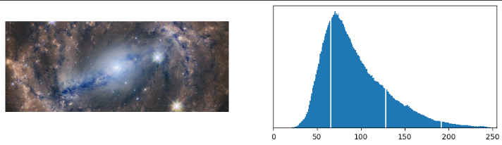
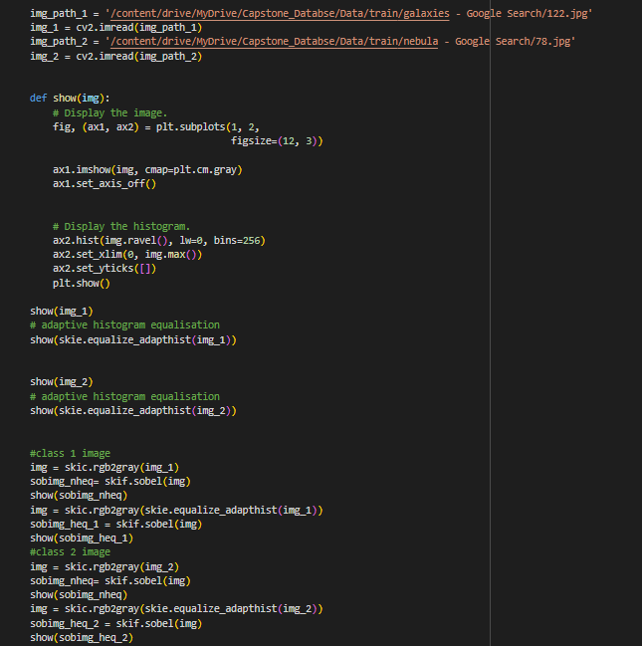
Exploratory Data Analysis
Lighting and illumination artifacts of Image
Examples of some images are shown
Numpy
Skimage
Cv2
Matplotlib

Slide 12
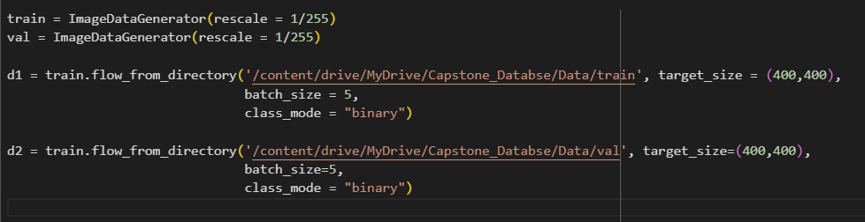
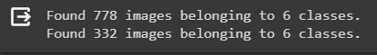
Predictive Data Analysis
Basic Command to track folder
Shows how many images in each class
Shows how many classes there are

Slide 13
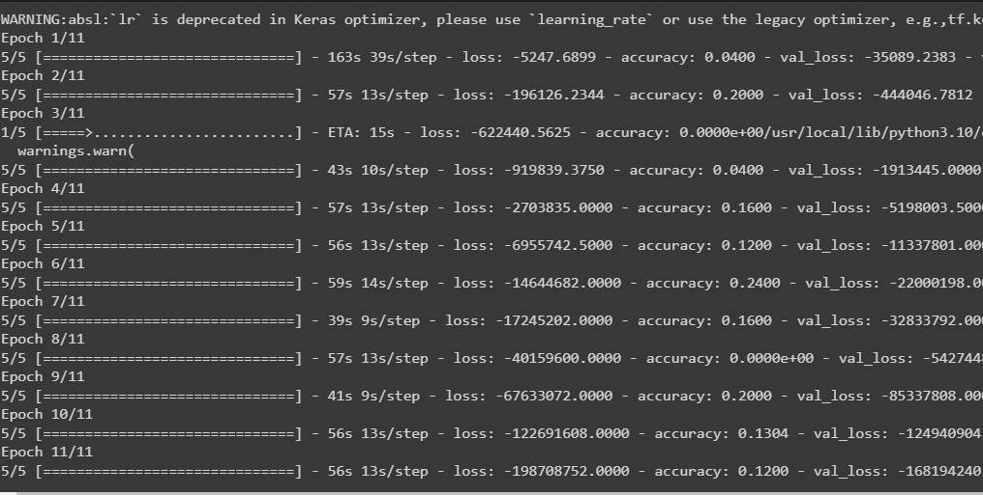
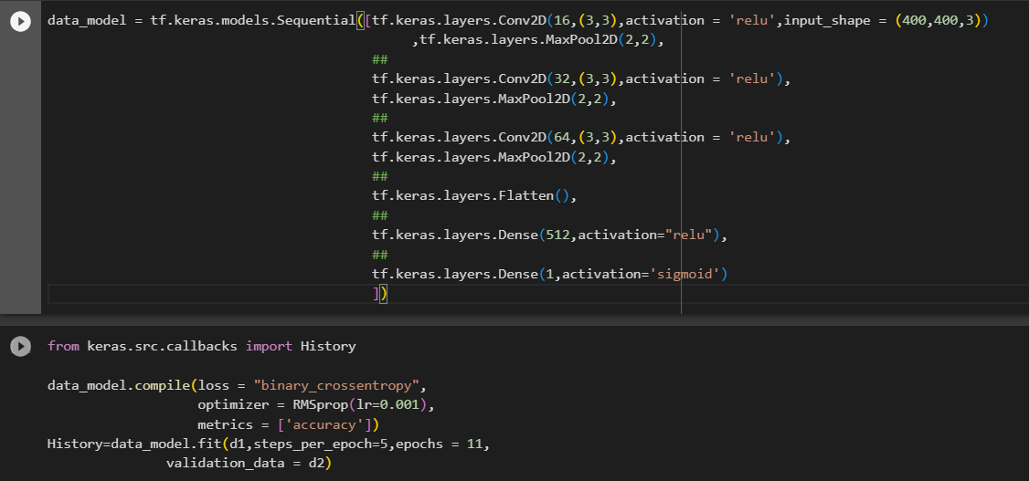
Predictive Data Analysis
Neural Network
Building Model
Compile Mode
Print epoch
Eleven epoch used in validation folder
Accuracy score and loss are outputted in epoch

Slide 14
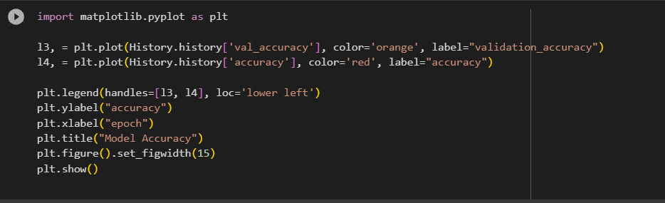
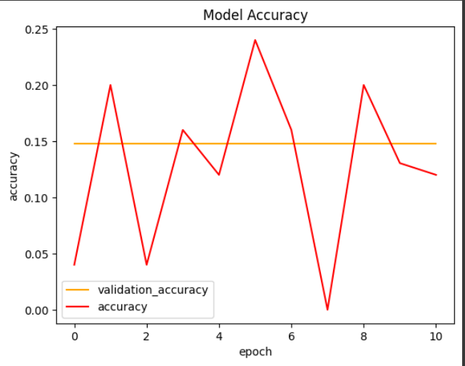
Predictive Data Analysis
Model Accuracy based on Epoch
Only for Validation Folder
Accuracy is constantly changing while the validation accuracy is consistent.

Slide 15
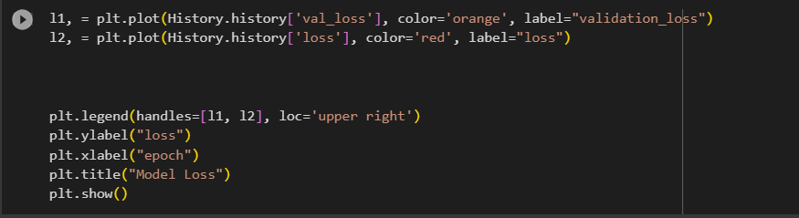
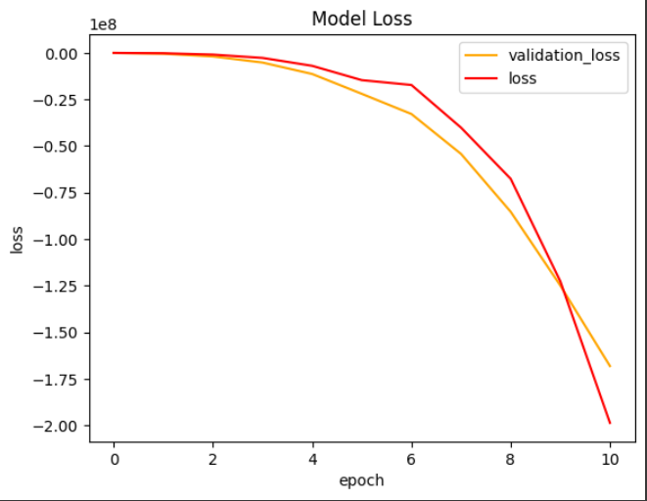
Predictive Data Analysis
Model Loss based on epoch
Only for Validation Folder
Ordinary Loss and Validation Loss are both similar.

Slide 16
Implementation Plan
Haven’t started the implementation as I am still working on PDA
Plan to use Streamlit to build an app relating astronomy, such as astronomy data analysis page or an Image comparison tool
Or use tkinter to build a basic Image measurement app, where the user inputs an image and the output is the measurements of said object.

